Slide 1
Deep Entity Matching for Dataset with Numeric Attributes
Lydia CHau

Slide 2
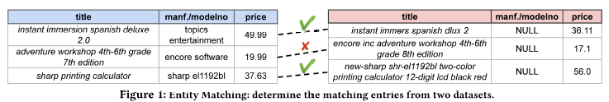
Entity Matching (EM)
Refers to the problem of determining whether two data entries refer to the same real-world entity.
For example, an application of EM is to determine whether the product descriptions from Amazon dataset and Walmart dataset are referring to the same product.

Slide 3
Entity Matching Problems
Structured EM
Dirty EM
Textual EM

Slide 4
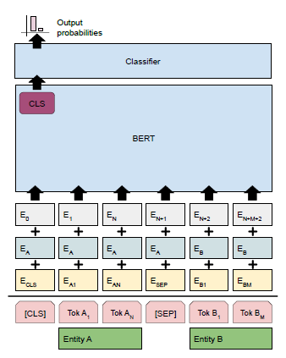
Related Work
Use large pre-trained language model
E.g. BERT
Brunner, U. and Stockinger, K., 2020. Entity matching with transformer architectures-a step forward in data integration. In International Conference on Extending Database Technology, Copenhagen, 30 March-2 April 2020. OpenProceedings.
Li, Y., Li, J., Suhara, Y., Doan, A. and Tan, W.C., 2020. Deep entity matching with pre-trained language models. arXiv preprint arXiv:2004.00584. (DITTO)

Slide 5
Problem
The pre-trained language models are good at handling text data but not numeric data
In particular, currently, the BERT model does not recognize negative numbers or floating point numbers

Slide 6
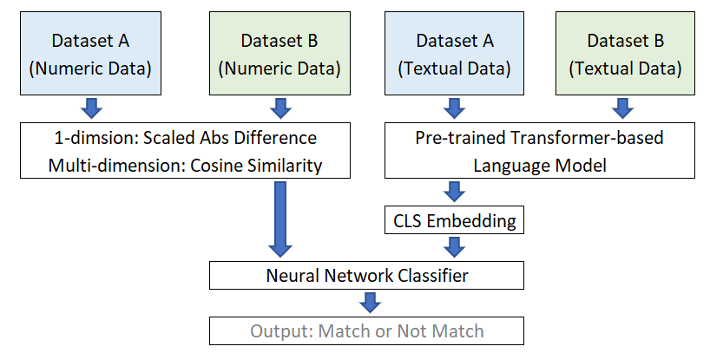
Proposed Model

Slide 7
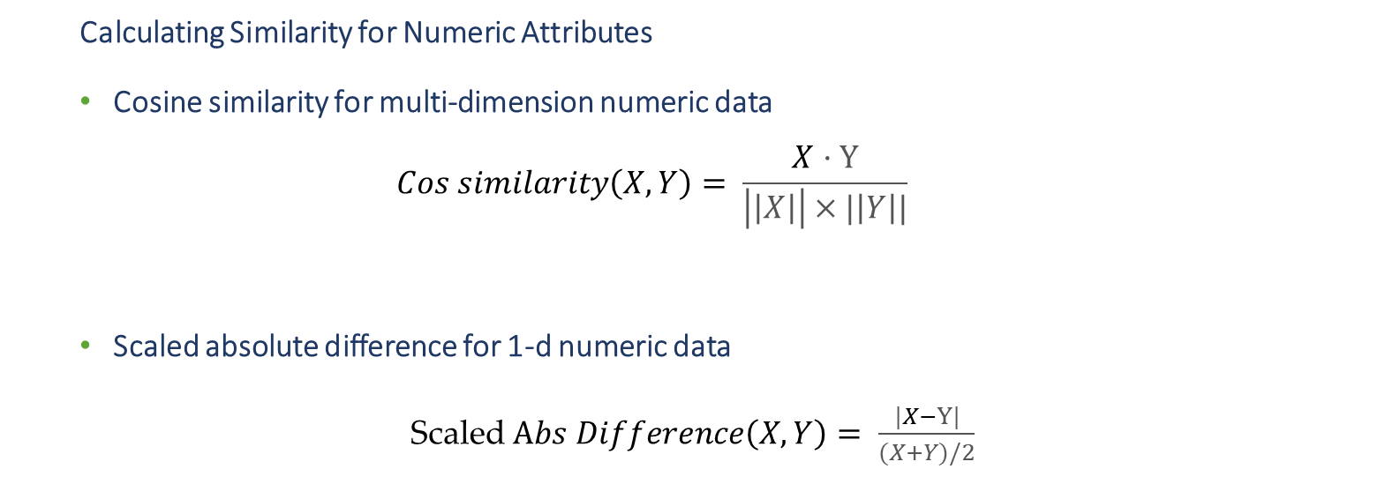
Implementation Details - Numeric Attributes
  Calculating Similarity for Numeric Attributes
  Cosine similarity for multi-dimension numeric data
  $$Cos similarity\left(X, Y\right)= \frac{X·Y}{\left|\left|X\right|\right|×|\left|Y\right||}$$
  Scaled absolute difference for 1-d numeric data
  Scaled $Abs Difference\left(X, Y\right)= \frac{|X−Y|}{(X+Y)/2}$

Slide 8
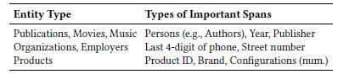
Implementation Details – Text Data
Knowledge Injection (from DITTO)
Domain knowledge is injected by highlighting important pieces of input information that may be of interest when making matching decisions.
Data Augmentation (from DITTO)

Slide 9


Implementation Details – Language Model
Input id
Attention mask
Segment id

Slide 10
Implementation Details - Classifier
  Neural Network Classifier
Dataset | Model | Model with 1 additional hidden classification layer
Dirty/iTunes-Amazon | 92.86% | 93.11%
Dirty/Walmart-Amazon | 90.16% | 90.16%
Structured/Amazon-Google | 91.20% | 90.80%
Structured/Walmart-Amazon | 90.49% | 89.51%

Slide 11
Implementation Details - Sampler
  Weighted Training Data Sampler
Dataset | Model With Random Sampler | Model Weighted Random Sampler
Dirty/iTunes-Amazon | 92.86% | 91.53%
Dirty/Walmart-Amazon | 90.16% | 89.68%
Structured/Amazon-Google | 91.20% | 88.05%
Structured/Walmart-Amazon | 90.49% | 90.49%

Slide 12
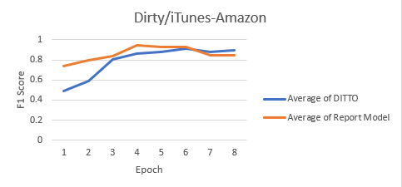
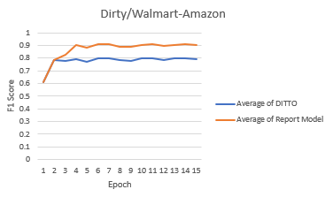
Proposed Model Performance - Dirty

Slide 13
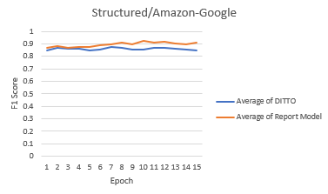
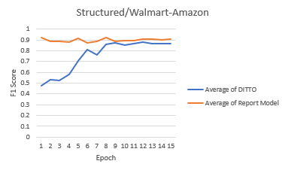
Proposed Model Performance - Structural

Slide 14
Model Limitations/ Future Extension
The current model assumes that the pair of datasets has the same attributes. In particular, the model can only match dataset with identical numeric attributes. These limitations affect the robustness of the model.
The model only separately handles attributes that are completely numeric but not attributes that have a mix of text and numbers, e.g., a sentence that has number in it.

